Slide 1
Spinal cord reflexes Lecture1 and 2
Mustafa Al-Badran CABM FIBMS
Department of Medicine
College of Medicine\ University of Basrah

Slide 2
Objectives
1. Reflex Arc
2. Types of Reflex arch
3. Stretch reflex components and physiology
4. Golgi tendons
5. Component and Mechanism of inverse stretch reflex
6. Withdrawal reflex
University of Basrah-College of Medicine-Physiology Department
1

Slide 3
Bell-Magendie law
In the spinal cord
the dorsal roots are sensory
the ventral roots are motor
University of Basrah-College of Medicine-Physiology Department
2

Slide 5
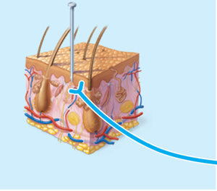
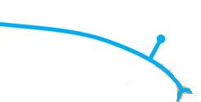
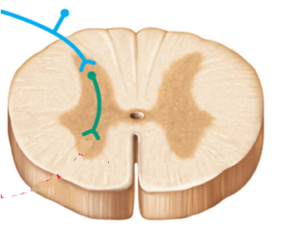
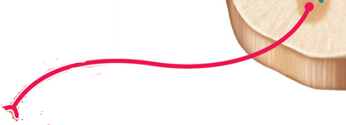
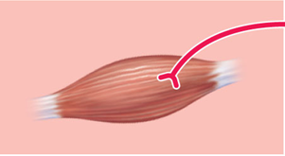
Reflex arc
Stimulus
Skin
Interneuron
1
Receptor
2
Afferent nerve
3
Integration center
4
Efferent nerve
5
Effector
Spinal cord
University of Basrah-College of Medicine-Physiology Department
3

Slide 6
Reflex arc
Monosynaptic
Polysynaptic
University of Basrah-College of Medicine-Physiology Department
4

Slide 7
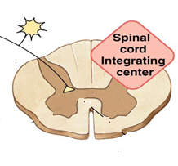
Monosynaptic
One synapse
University of Basrah-College of Medicine-Physiology Department
5

Slide 8
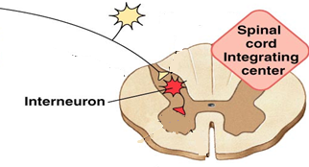
Polysynaptic
Synapse 1
Synapse 2
University of Basrah-College of Medicine-Physiology Department
6

Slide 9
Monosynaptic
Stretch reflex
University of Basrah-College of Medicine-Physiology Department
7

Slide 10
Stretch reflex
reflex contraction of the stretched muscle
sudden stretch of a muscle
University of Basrah-College of Medicine-Physiology Department
8

Slide 11
Components of Stretch reflex
Receptor
Muscle spindle (intrafusal fibers)
Annulospiral endings (Ia fibres)
+
Flower Spray endings (II fibres)
Afferent
Integrating center
Spinal cord
Efferent
Motor nerve (alpha fibers)
Muscle (extrafusal fibers)
Effector
University of Basrah-College of Medicine-Physiology Department
9

Slide 12
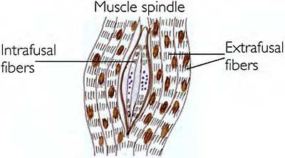
University of Basrah-College of Medicine-Physiology Department
10

Slide 13
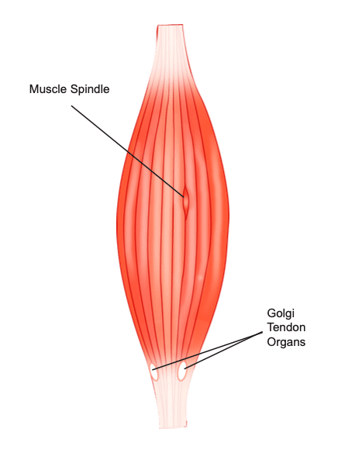
Stretch Reflex Receptor (Muscle Spindle)
Muscle spindle consists of 3-12 small muscle fibres (intrafusal fibres)within connective tissue capsule parallel to extrafusal fibres & attached to it or to tendons
University of Basrah-College of Medicine-Physiology Department
11

Slide 14
Each intrafusal fibre has:
Central non contractile part
Peripheral contractile part
Receptor
on sides of central zone has actin& myosin
University of Basrah-College of Medicine-Physiology Department
13

Slide 15
University of Basrah-College of Medicine-Physiology Department
12

Slide 16
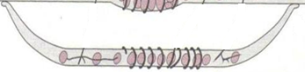
Two types of intrafusal fibres:
1-Nuclear bag fibres
Central area is dilated with group of nuclei
2-Nuclear chain fibres
Thinner& shorter
One line of nuclei in a chain in the receptor zone
Bind to nuclear bag on each side
University of Basrah-College of Medicine-Physiology Department
14

Slide 17
two subtypes of nuclear bag fibers
Dynamic
Static
Nuclear chain fibres
Static
University of Basrah-College of Medicine-Physiology Department
15

Slide 18
University of Basrah-College of Medicine-Physiology Department
16

Slide 19
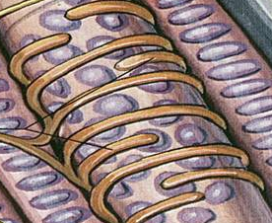
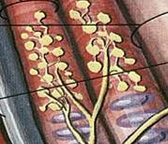
Innervation of the Muscle Spindle
It has afferent & efferent nerve fibers
Sensory Afferent fibres: Central receptor area of the intrafusal muscle fibres is supplied by TWO types of afferent fibres
A-Primary (Annulospiral) endings (Ia fibres): fast, encircle receptor areas of both nuclear bag and nuclear chain fibres
B-Secondary (Flower-Spray) (Group II) sensory endings: supplying receptor area of the nuclear chain fibres only
University of Basrah-College of Medicine-Physiology Department
17

Slide 20
Both the Primary and the Secondary endings respond to the static response (Discharge throughout the period of sustained stretch)
The Primary endings (but not the secondary ending) respond to the dynamic response (Discharge most rapidly if the muscle is suddenly stretched as in tendon jerks)
University of Basrah-College of Medicine-Physiology Department
19

Slide 21
Efferent fibres to spindle (Anterior Motor Neurons)
Gamma motor neurons >>>>gamma efferent 30% >>>>> to the peripheral contractile parts of the intrafusal muscle fibres
70% >>> Alpha efferent to extrafusal muscle fibres
Effect of Gamma efferent discharge:-
Gamma efferent increase sensitivity of muscle spindle to stretch
20

Slide 22
21

Slide 23
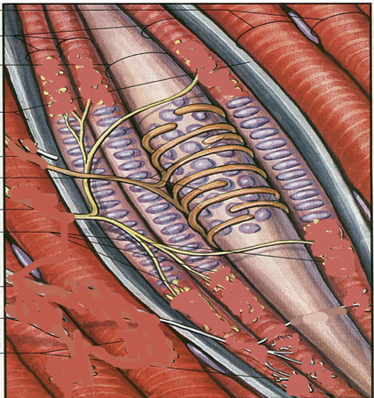
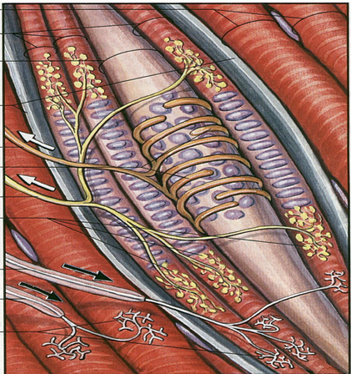
Intrafusal fibers
Nuclear chain with
Flower Spray endings
Nuclear bag with Annulospiral endings
Extrafusal fibers
Gamma fiber
Alpha fiber
University of Basrah-College of Medicine-Physiology Department
22

Slide 24
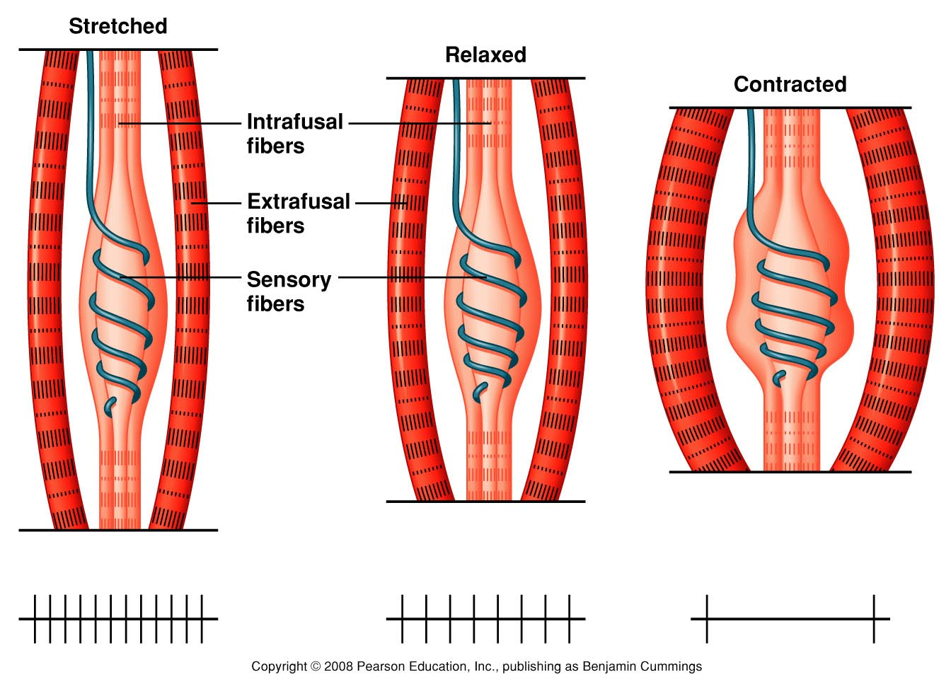
23

Slide 25
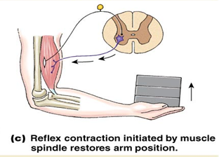
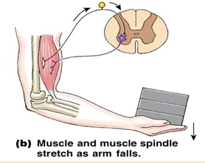
+
+
+
+
University of Basrah-College of Medicine-Physiology Department
24

Slide 26
Types of responses (Component of stretch reflex)
1-Dynamic stretch reflex (Dynamic Response)
Jerk movement
Sudden rapid stretch of a muscle >>>>>
University of Basrah-College of Medicine-Physiology Department
25

Slide 27
This is the basis of Tendon Jerk
( contraction followed by relaxation)
Why relaxation follow the contraction?
When muscle contract, it shortens, muscle spindle relax>>> no discharge of nerve endings, and muscle relax
University of Basrah-College of Medicine-Physiology Department
26

Slide 28
2- Static stretch reflex(Static Response)
Mild sustained contraction of muscle extrafusal fibers as long as it is stretched (Basis of muscle tone)
University of Basrah-College of Medicine-Physiology Department
27

Slide 29
knee jerk
Clinical example of stretch reflex
University of Basrah-College of Medicine-Physiology Department
28

Slide 30
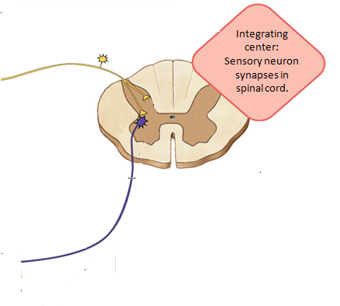
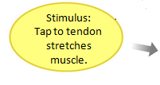
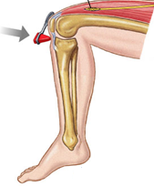
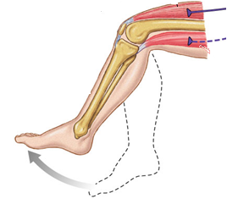
University of Basrah-College of Medicine-Physiology Department
29

Slide 31
Functions of Muscle Spindle
1- Keep CNS informed about muscle length & rate or velocity of change in muscle length
2-Muscle spindle act to maintain muscle length against rupture
Muscle spindles monitor muscle length and prevent overstretching of the muscle
3- Damping function (Smoothing muscle contraction)
University of Basrah-College of Medicine-Physiology Department
30

Slide 32
In a muscle spindle receptor, which type of muscle fiber is responsible for the dynamic response?
A) Extrafusal muscle fiber
B) Smooth muscle fiber
C) Nuclear chain fiber
D) Nuclear bag fiber
University of Basrah-College of Medicine-Physiology Department
31

Slide 33
Reciprocal inhibition with Stretch Reflex
Reflex contraction of an agonistic muscle is accompanied by inhibition of the antagonistic muscle ex: (contraction of biceps + inhibition of the triceps)
University of Basrah-College of Medicine-Physiology Department
32

Slide 34
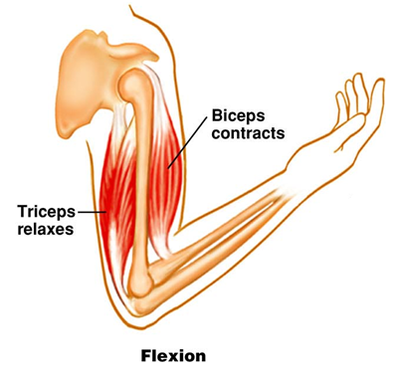
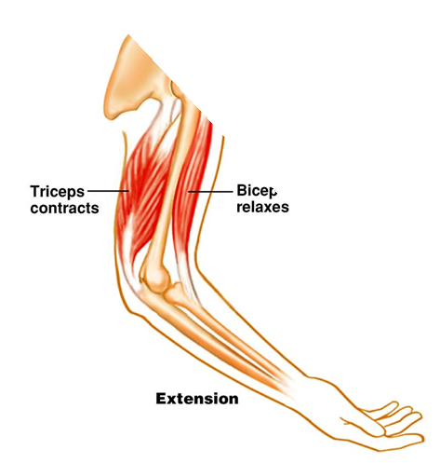
Antagonistic Muscles
University of Basrah-College of Medicine-Physiology Department
33

Slide 35
Impulses from stretched muscle>>>> Spinal cord to cause:-
1-Stimulate the motor neurons of the stimulated muscle
2- Send collaterals >>>> Inhibitory Interneurons synapse on the AHCs of the antagonistic muscle & inhibit them
University of Basrah-College of Medicine-Physiology Department
34

Slide 36
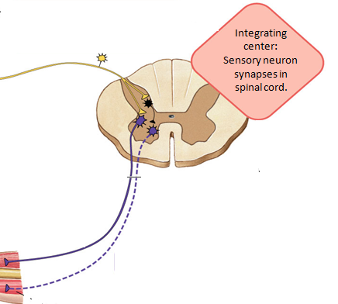
University of Basrah-College of Medicine-Physiology Department
35

Slide 37
Stretch of an innervated muscle evokes :
A- contraction of its spindles
B- contraction of its extrafusal fibers
C- contraction of antagonistic muscles
D- relaxation of synergistic muscles
University of Basrah-College of Medicine-Physiology Department
36

Slide 38
Polysynaptic
Inverse stretch reflex
Withdrawal reflex
University of Basrah-College of Medicine-Physiology Department
37

Slide 39
Inverse stretch reflex (Golgi Tendon Reflex)
Golgi tendon organs
Receptor
Afferent
Type Ib sensory nerve fibres
Integrating center
Spinal cord
Efferent
Motor nerve (alpha fibers)
Muscle
Effector
University of Basrah-College of Medicine-Physiology Department
38

Slide 40
Golgi Tendon Organs
Golgi Tendon Organs are sensory receptors in muscle that respond to tension changes in the muscle and attempt to prevent injury from excessively strong contractions
University of Basrah-College of Medicine-Physiology Department
39

Slide 41
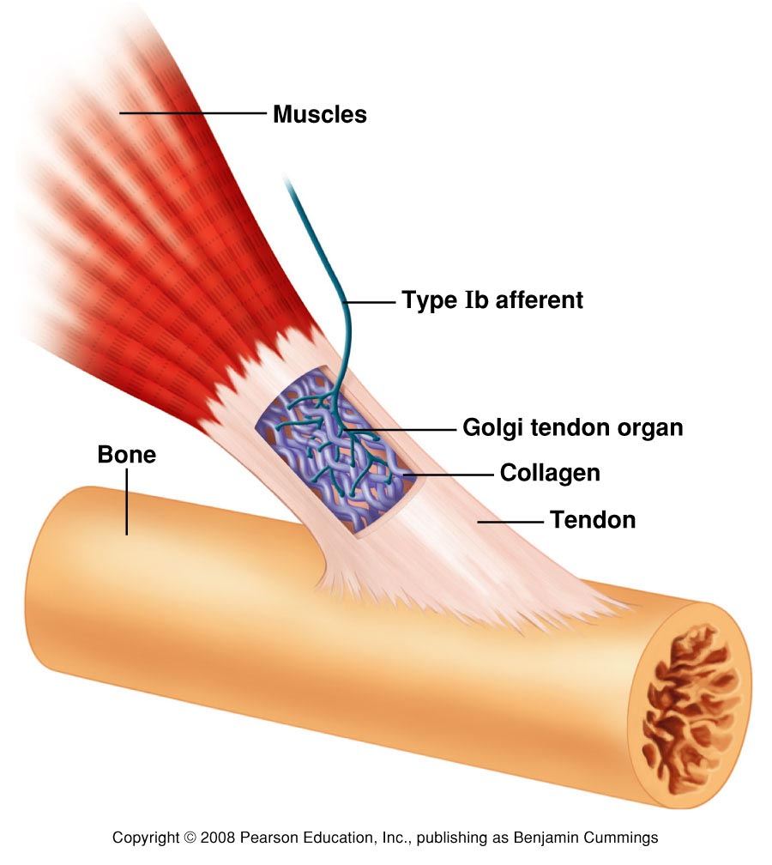
Golgi Tendon Organs
University of Basrah-College of Medicine-Physiology Department
40

Slide 42
University of Basrah-College of Medicine-Physiology Department
41

Slide 43
When muscle tension is increased (by active muscle contraction), the Golgi tendon organ is stimulated
Signals are sent to spinal cord to synapse with inhibitory interneuron's that in turn inhibit the anterior alpha motor neurons innervate the same muscle from which signals were originated
This relaxation in response to strong stretch is called inverse stretch reflex
University of Basrah-College of Medicine-Physiology Department
42

Slide 44
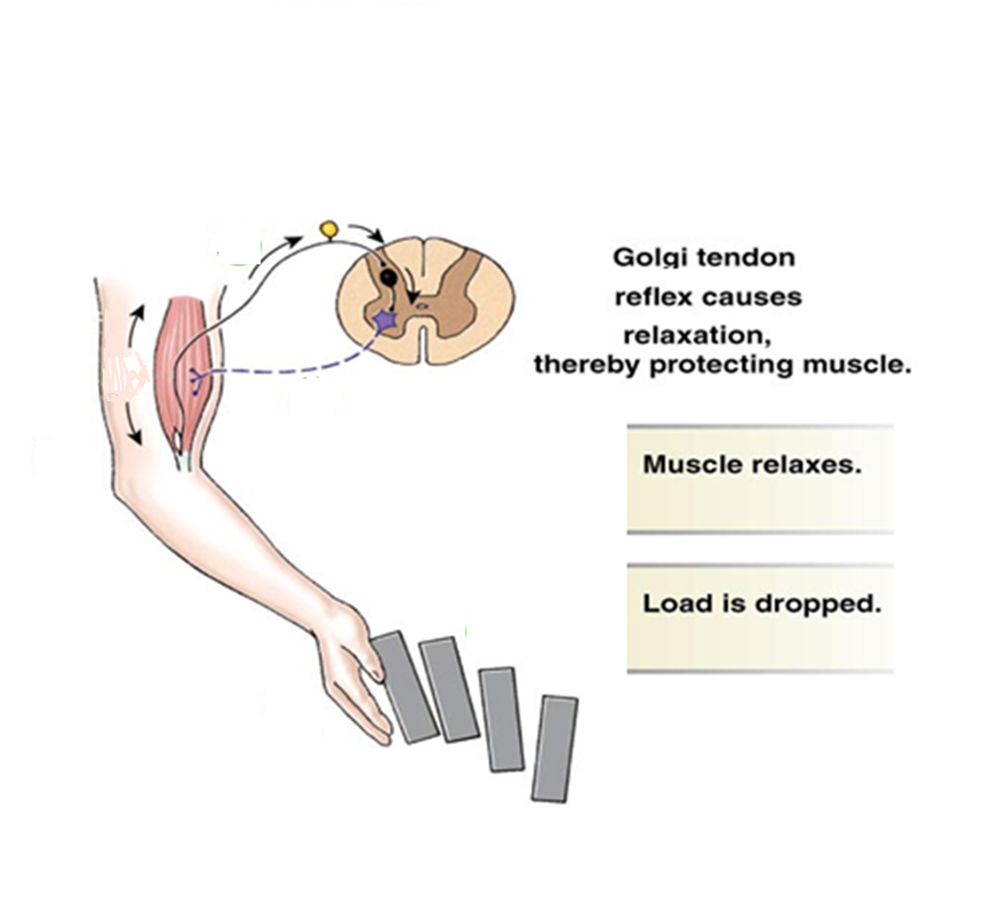
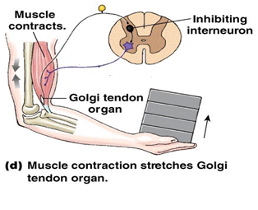
+
+
+
+
-
+
-
+
43

Slide 45
When the tension becomes too little, impulses from the tendon organ ceases and the loss of inhibition leads to activation of alpha motor neurons again
University of Basrah-College of Medicine-Physiology Department
44

Slide 46
This reflex
Prevents tearing of the muscle or avulsions of tendon from its attachment to the bone
Equalize the contractile forces of the separate muscle fibres
University of Basrah-College of Medicine-Physiology Department
45

Slide 47
Which cells receive direct synaptic input from Golgi tendon organs?
A) Type Ia neurons
B) Gamma motor neurons
C) Alpha motor neurons
D) Type Ib neurons
E) Type II neurons
University of Basrah-College of Medicine-Physiology Department
46

Slide 48
A tendon jerk :-
A- Is a dynamic stretch reflex
B- Is a static stretch reflex
C- Is evoked by gradually stretching the muscle
D- Is evoked by stimulation of tendon receptors
University of Basrah-College of Medicine-Physiology Department
47

Slide 49
Withdrawal Reflex
it’s a polysynaptic reflex that occur in response to a painful stimulation of the skin or subcutaneous tissue & the response is
A. Flexor muscle contraction & inhibition of extensor muscles (Reciprocal Inhibition Circuits) so that the body part stimulated is flexed & withdrawn from the stimulus
B. extension of the opposite limb (Cross Extensor Response)
University of Basrah-College of Medicine-Physiology Department
48

Slide 50
The neuronal mechanism involved in the flexor & extensor reflexes
The painful stimuli pass from sensory nerve into a group of interneurons of the same side of the cord and then to
The anterior motor neurons to elicit withdrawal of the affected limb
Through many interneurons the stimuli cross to the opposite side of the cord to cause cross extension
University of Basrah-College of Medicine-Physiology Department
49

Slide 51
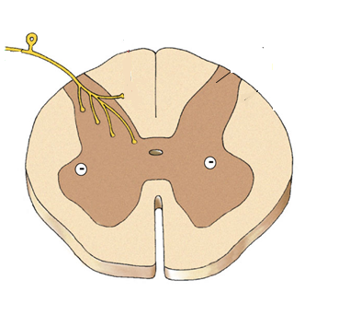
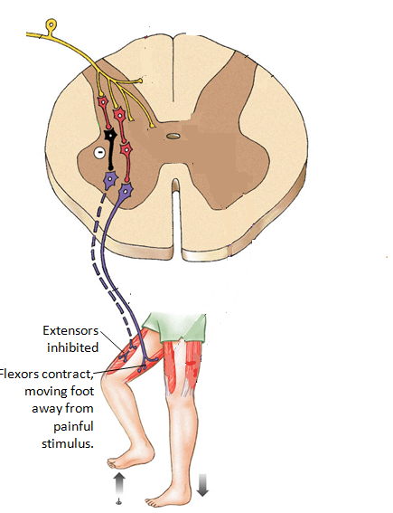
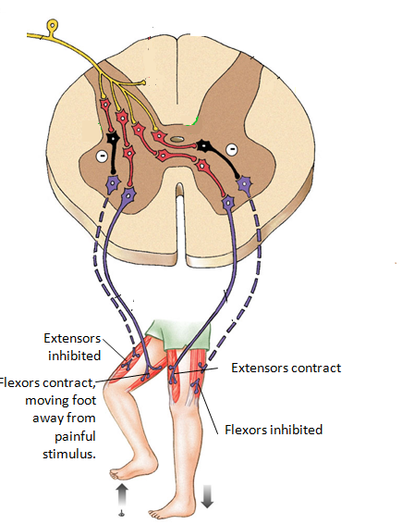
reciprocal inhibition
University of Basrah-College of Medicine-Physiology Department
(Cross Extensor Response)
50

Slide 52
29-year-old man steps on a broken bottle with his bare right foot. His right leg immediately lifts while his left leg extends before he can consciously react to the pain.
This action is attributable to which reflex?
A) Walking reflex
B) Stretch reflex
C) Patellar tendon reflex
D) Golgi tendon reflex
E) Withdrawal reflex
University of Basrah-College of Medicine-Physiology Department
51

